Slide 1
URBAN TREE MANAGEMENT FOR THE CITY OF DÜSSELDORF Beate, Kerstin, Merve, Muktadir, Dominik

Slide 2
Agenda
Potential topics for the presentation
Intro & Team
Idea and Project Outline
Problems & Solutions
Learnings
Demo

Slide 3
What makes a city worth to live in?
Intro & Team
Good infrastructure
Good cultural offering
Big parks
Optimal weather conditions
Trees within the city
Active nightlife
Diverse society
Sport clubs

Slide 4
Who has worked on this project?
Intro & Team
Bild
Beate
Kerstin
Bild
Bild
Merve
Muktadir
Dominik
France
Profession
Germany
Media Developer/ Analyst
Turkey
Neuroscientiest
?
Profession
Germany
Sales Manager

Slide 5
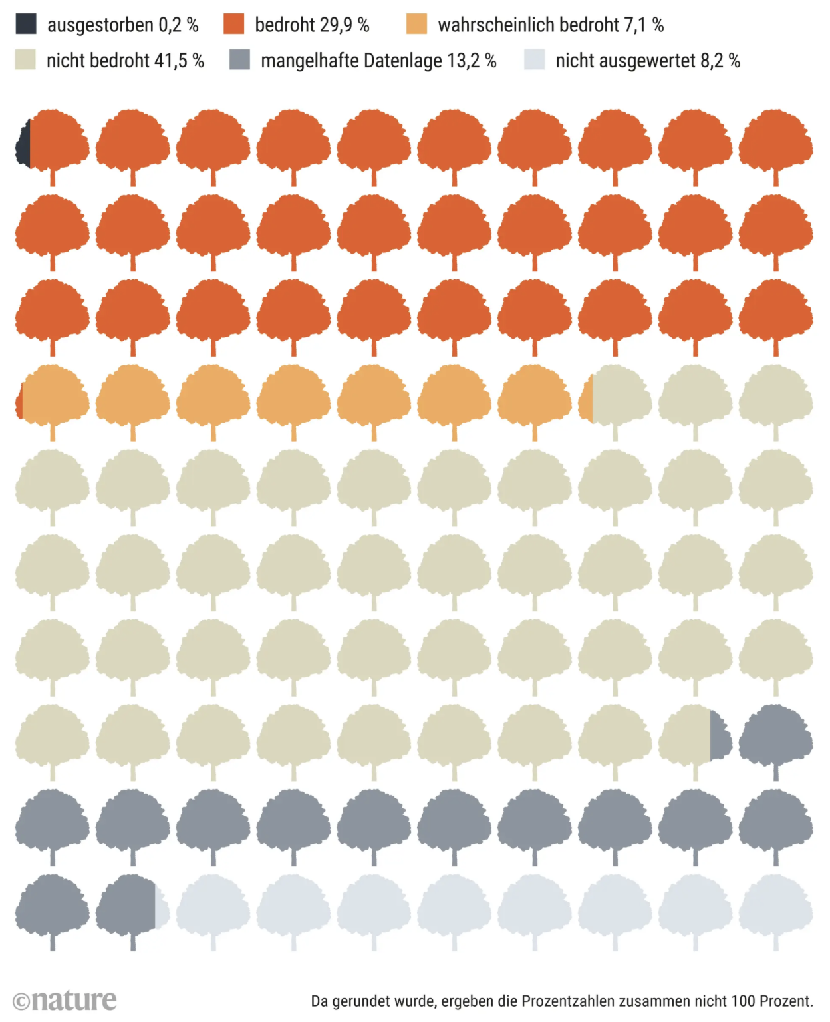
Which problem do we would like to work on?
Problem
Endangered trees
Are our trees in Dusseldorf in danger?
https://www.spektrum.de/news/baumsterben-die-letzten-ihrer-art/2057895

Slide 6
How are we able to analyze the situation in Düsseldorf?
Solution
Urban Tree Management
Which and where are trees existing in Dusseldorf?
How to qualify if the tree can survive in Dusseldorf?
Which weather conditions are affecting the trees in the city?

Slide 7
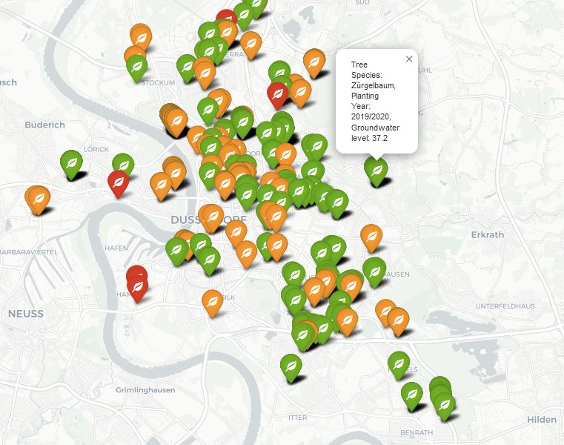
What was the result of our research?
Solution
Key Take-aways
Dusseldorf has still lots of trees that are not perfectly fitted for the environmental conditions!
Dusseldorf is nowadays planting more trees that are better weather resistant.
Screenshots

Slide 8
Learnings
Some ideas for this section
Project Management
Coding
Using available tools
What do we have learned?
General knowledge about Python programming
Understanding code and coding enviorment that was used
Coordination of distributed teams
What would we like to do different?
Having more face2face sessions
Having more often coordination meetings
Distributing the work fairer between the group members
There is data available for every problem to be analysed!

Slide 9
Demo
Some ideas for this section

